Slide 1
Rezidive nur an der Crosse ?
VARICI RECIDIVE SOLO ALLA CROSSE?
Recurrent VV only in the groin?
JA Ebner**, H Ebner *,
* SVGTCHIR, ** CHIRURGIA VASCOLARE E TORACICA
Ospedale Centrale Bolzano

Slide 3
Recurrent VV only in the groin?
References
on Recurrent VV
RVV
in general
57 Crosse,SFJ
24 random stud.
12 Neovascularisation
4 SPJ
5 perforators

Slide 4
Recurrent VV only in the groin?
22 selected papers 2000-2013
Recurrences
15 Groin
68%
8 Perforators
36%
9 other
41%
Listed alone
5 1 1
6 Listed together
27%

Slide 5
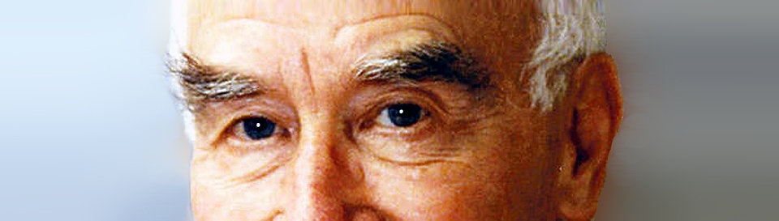

Auszeichnung für eine wissenschaftliche Arbeit, die sich mit den Ursachen der Rezidivvarikosis unter
spezieller Berücksichtigung der Anatomie der Crossenregion beschäftigt.

Slide 6
Recurrent VV only in the groin?
Possible explanations
SFJ Incompetence main cause of VV
More Duplex on Controls
Easier to diagnose ?
Discussion on Neovascularisation
More often symptomatic ?
Most frequent side of reintervention
End point in comparative studies

Slide 7
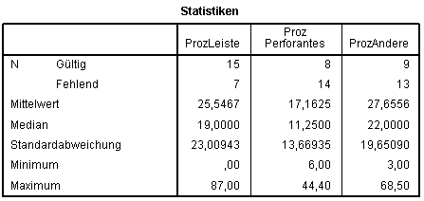
Recurrent VV only in the groin?
22 selected papers 2000-2013
%

Slide 8
Recurrent VV only in the groin?
534 Radical Babcock-Cockett Interventions 1998-2003
SFJ Flush ligation,GSV stripping,ligature of perforators, multiple flebectomies
for SFJ insufficiency, GSV VV,collateral VV,
one or more insufficient perforators,
at least C2

Slide 9
Recurrent VV only in the groin?
Follow-up 120± 21 m
534 Legs operated 100%
61 Lost for Follow-up 11,4%
473 approached 88,6%
73 by telephone 13,6%
400 Examinated 74,9%
Anamnestic,Clinical,Duplex Control
by independent investigators

Slide 10
Assessment Recurrence
Clinical: visible or palpable VV
Duplex: VV > 3mm
SFJ Reflux > 0,5 sec
Fischer type B1,2 and C
Dilated perforators

Slide 11
Recurrent VV only in the groin?
RESULTS
Recurrent VV
Subjective estimation
Subjective estimation
Same Site of Op.
24,5%
Different Site
15,3%
39,8%
Clinically visible VV
45,2%

Slide 12
Recurrent VV only in the groin?
RESULTS
Recurrent VV
Duplex and clinical Ex.
Clinical/ /Duplex | Clinical + Duplex | Only Duplex | total
No RVV | 134 (33,5%) | 0 | 134 (33,5%)
RVV | 182 (45,5%) | 84 (21%) | 266 (66,5%)
total | 318 (79,5%) | 84 (21%) | 400 (100%)

Slide 13
RESULTS
Recurrent VV
Recurrent VV only in the groin?
Site | Clinical + Duplex | Only Duplex | total | %
Groin, Groin+thigh Groin+thigh+leg | 45 | 26 | 71 | 26,7%
Groin+leg | 18 | 3 | 21 | 7,9%
Groin+popl.fossa+leg | 5 | 0 | 5 | 1,9%
GROIN ++ | 68 | 29 | 97 | 36,5%
Thigh Thigh+leg | 38 | 13 | 51 | 19,2%
Thigh+popl.fossa+leg | 3 | 0 | 3 | 1,1%
THIGH | 41 | 13 | 54 | 20,3%
Popliteal fossa Popl.fossa+ leg | 10 | 1 | 11 | 4,1%
++ popl. fossa | 8 | 0 | 8 | 3,0%
POPL.FOSSA | 18 | 1 | 19 | 7,1%
Leg | 65 | 39 | 104 | 39,1%
++ leg | 98 | 8 | 106 | 39,8%
LEG | 163 | 47 | 210 | 78,9%
Duplex//and Clinical SITE
Site | Clinical + Duplex | Only Duplex | total | %
Leg | 65 (24,4%) | 39 (14,6%) | 104 | 39%
Groin+thigh+leg | 40 (15,0%) | 0 | 40 | 15%
Thigh+leg | 30 (11,2%) | 5 (1,8%) | 35 | 13%
Groin | 1 (0,3%) | 24 (9%) | 25 | 9,4%
Groin+leg | 18 (6,7%) | 3 (1,1%) | 21 | 7,9%
Thigh | 8 (3%) | 8 (3%) | 16 | 6%
Popliteal fossa | 8 (3%) | 1 (0,3%) | 9 | 3,4%
Groin+popl.fossa+leg | 5 (1,8%) | 0 | 5 | 1,9%
Groin+thigh | 4 (1,5%) | 2 (0,7%) | 6 | 2,2%
Thigh+popl.fossa+leg | 3 (1,1%) | 0 | 3 | 1,1%
Popl.fossa+leg | 2 (0,7%) | 0 | 2 | 0,7%

Slide 14
Recurrent VV only in the groin?
RESULTS
Recurrent VV
Source of Recurrence
Source | n | %
One perforator | 86 | 32,3%
2 to 4 perforators | 32 | 12%
SFJ | 45 | 16,9%
SFJ+ 1 to 3 perf. | 43 | 16,2%
SFJ+SPJ+perf. | 8 | 3%
SPJ | 22 | 8,3%
No source | 30 | 11,3%

Slide 15
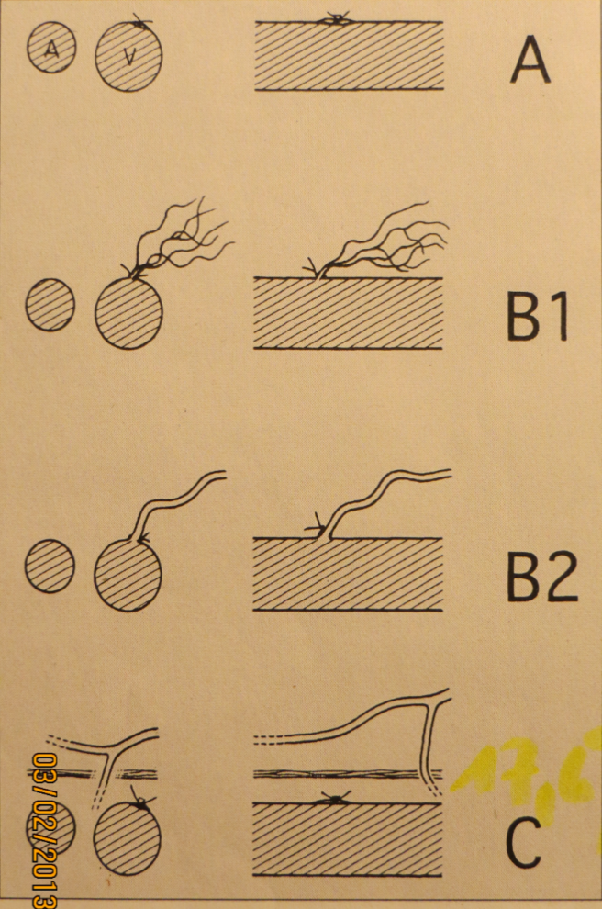
RESULTS
Recurrent VV
Recurrent VV only in the groin?
SFJ Duplex
Fischer Classification | n | %
A | 304 | 76,0%
B1
B2 | 43 | 10,7%
C
 | 49 | 12,2%
 | 4 | 1,0%

Slide 16
Recurrent VV only in the groin?
CONCLUSIONS
SFC Rec. is most often cited in Literat.
The reasons are multi-layered
Other sites are at least as frequent
We have to differentiate between clinically important lesions and merely technical findings
Also peripheral recurrences deserve
And need our attention

Slide 18
Rezidive nur an der Crosse ?
Zentrale rezidive
Als ursache für rez. Wichtiger
Aufgrund der Techniken mehr diskutiert
Rezidiv messbar
Opindikation zum reeingirff wird meist hier gestellt
Eigene Ergebnisse

